Slide 1

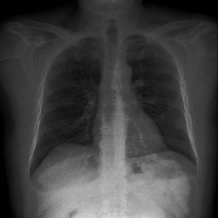
IMPACT HUB CHALLENGE
COVID-19 Detection in Chest X-ray images
using Deep Learning
Omdena Myanmar Impact Hub Challenge

Slide 2

THE PROBLEM:
IMPACT HUB CHALLENGE
As one of the most effective tools for identifying COVID-19, chest X-rays have played a crucial role in diagnosing and monitoring the progression of the disease. However, the manual interpretation of these images by healthcare professionals can be time-consuming and subjective, often leading to delays in diagnosis and potential errors.
Unfortunately, healthcare systems in many parts of the world, including Myanmar, face resource constraints, limited access to specialized expertise, and a lack of sophisticated diagnostic tools. These challenges hinder the timely detection and appropriate management of respiratory diseases, leading to increased morbidity and mortality rates.

Slide 3
Objective:
IMPACT HUB CHALLENGE
The goal is to leverage deep learning techniques to . . .
Develop an automated system capable of accurately detecting COVID-19.
Facilitate early detection and treatment
Improve Healthcare Outcomes
Create an Accessible Health Care Solution
Facilitate Knowledge Sharing and Education

Slide 4


Project duration
8 weeks
How we did it?
TIMELINE OF TASKS
IMPACT HUB CHALLENGE

Slide 5



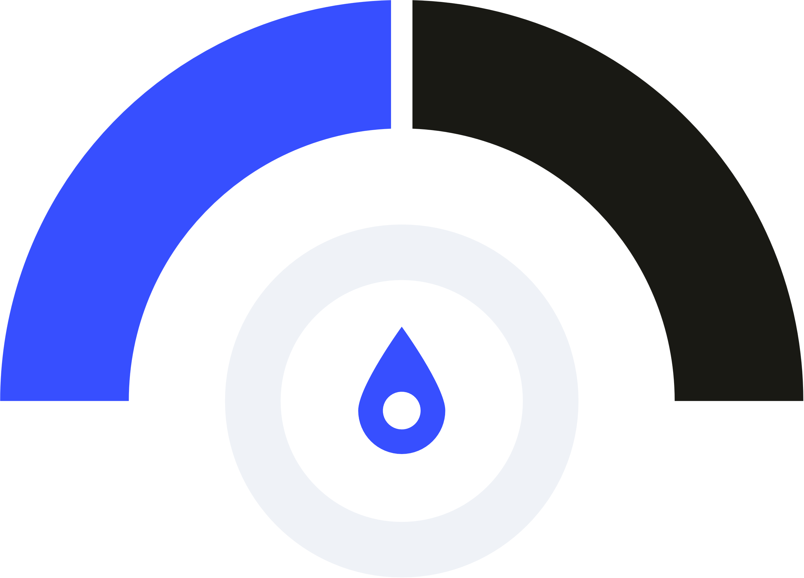



Web App Deployment
Finalize the project outcome and deploy model in a web app
Model Building and Evaluation
Different models with different architectures were built and evaluated.
EDA analysis
Uncovers insights from data, revealing patterns, outliers, and biases, aiding informed decision-making in various fields.
DATA Collection
Collect Data Sets
from various sources merge them, and preprocess them and doublecheck
IMPACT HUB CHALLENGE
Notes:
Data Collection: Week 1:
The researchers of Qatar University compiled 33920 Chest X-ray (CXR) images and segmentation masks for the COVID-QU-Ex dataset, but we opted to only use the CXR images for our models with out masks. The 11956 COVID images come from the following 7 repositories: -
QaTa-COV19 Database: https://www.kaggle.com/aysendegerli/qatacov19-dataset -
Covid-19-image-repository: https://github.com/ml-workgroup/covid-19-image-repository/tree/master/png -
Eurorad: https://www.eurorad.org/ -
Covid-chestxray-dataset: https://github.com/ieee8023/covid-chestxray-dataset -
COVID-19 DATABASE: https://www.sirm.org/category/senza-categoria/covid-19/ -
Kaggle COVID-19 Radiography Database: https://www.kaggle.com/tawsifurrahman/covid19-radiography-database -
GitHub COVID-CXNet: https://github.com/armiro/COVID-CXNet
The 11263 non-COVID infection (viral or bacteria pneumonia) and 10701 normal CXR images come from the following 3 repositories: -
RSNA Pneumonia Detection Challenge: https://www.kaggle.com/c/rsna-pneumonia-detection-challenge/data. -
Chest X-Ray Images (Pneumonia): https://www.kaggle.com/paultimothymooney/chest-xray-pneumonia. -
Medical Imaging Databank of the Valencia Region. PadChest: A large chest x-ray image dataset with multi-label annotated reports: https://bimcv.cipf.es/bimcv-projects/padchest/.
The original study was for a multi-class classification model (COVID-19, Non-COVID, and Normal), but we decided on a binary classification of COVID and non—COVID.The non-covid images included a combination of other lung diseases e.g.TB and; pneumonia and disease free images. Images were made available though a Google Drive - https://drive.google.com/drive/folders/1B9TP--bwofXNBL-QCH5_Y1BbvZB_PBFZ
EDA Analysis: Week 2,
note with images there is not a significant amount of EDA that can be done, but randomly manually reviewing images is recommended especially with any augmentation or morphology that is used in model pipelines, to insure quality of the image is preserved and that the is no ‘information loss’ due to poor transformations done to the images.
47k+ images from Kaggle, 33% Covid 67% non-Covid. Quality of some images appeared to have pre-processing augmentation although these do not appear to hinder model prediction.
There were duplicates or there were X-rays of the same patient with miniscule differences. Care was taken to insure an equal distribution of images from each class was selected when training.
Pixel distribution for images were reviewed. Covid images had a higher intensity (average pixel value) than non-covid.
Some images to the human eye appear to be of very poor quality but when a sample of these images was run through the final app, model accuracy appeared to be unhindered.
Model Building and Evaluation: Week 2 to 7
Members volunteered for the modelling tasks. Interest was shown to work on custom models or transfer learning and; to work as part of team or solo.
Surveys were conducted with team members to establish their preferences.
Teams were created for those who wished to work in a team. Poles were done to co-ordinate meeting schedules to insure high as possible attendance rates. Meeting notes and recordings were distributed accordingly.
Transfer Learning models that were explored included Resnet, Xception, VGG-19, MobileNetV2.
Xception was the most accurate with an even balance for scores across validation and final test set and was the model selected for the app.
One team member built a custom model which came 2nd in the final accuracy test which is really impressive but it was not as balanced on val (94.4%) and test (97.1%) accuracy scores.
Web Deployment: Week 8
A simple and easy to use App was designed and deployed, it only requires the user to upload an image and prediction is automatic once the image is uploaded.

Slide 6
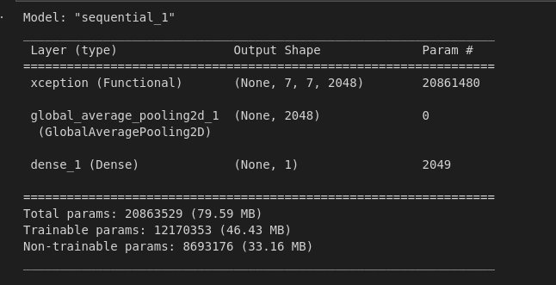
Best model:
The best model was created by Lemi Debela using Xception transfer learning with an additional GlobalAveragePooling layer before the final dense layer for classification.
The last 50 layers of Xception were trained.
A Learning Rate Scheduler was used with a custom decay rate of 1e-8 * 10 ** (epoch/10)
Classification report:
 | Precision | Recall | f1-score | Support
0 | 0.98 | 0.99 | 0.99 | 7927
1 | 0.92 | 0.90 | 0.91 | 1081
Accuracy |  |  | 0.98 | 9208
Macro avg. | 0.95 | 0.95 | 0.95 | 9208
Weighted avg | 0.98 | 0.98 | 0.98 | 9208
IMPACT HUB CHALLENGE

Slide 7
Alternative Architectures:
IMPACT HUB CHALLENGE
Luke Gomm: VGG-19
Classification report:
My best performing model was with VGG-19. I opted to train the final 6 layers within VGG-19 and added 3 custom dense layers (1024, 512, 64) before the final dense layer for the classification. I used a learning rate scheduler with a decay rate, utilized the ema_momentum and set epsilon to 0.1 in the Adam Optimizer as per research.
I opted to do combine Top Hat and Bottom Hat (Black Hat, with Contrast Limited Adaptive Histogram Equalization (CLAHE) to enhance the images and then added Gaussian blur to lift the areas in the x-ray where covid existed. No additinal augmentation was used.
The model achieved a val_accuracy of 96.8% and a final accuracy on a blind test data set of 98%.
 | Precision | Recall | f1-score | Support
0 | 0.99 | 0.99 | 0.99 | 7927
1 | 0.93 | 0.94 | 0.93 | 1281
Accuracy |  |  | 0.98 | 9208
Macro avg. | 0.96 | 0.96 | 0.96 | 9208
Weighted avg | 0.98 | 0.98 | 0.98 | 9208

Slide 8
Conclusions:
An accuracy of 96.6% is commendable but ideally one greater than 98% is desirable which, could be achieved by the following:
Additional time committed to hyper parameter tuning
Additional research and parameter tuning on Image Enhancement Techniques
Applying a lung segmentation masking algorithm (e.g. unet) to the images to isolate the lungs
The use of GPUs to expedite training and testing processes
IMPACT HUB CHALLENGE
Notes:
CAVEAT! It is possible to test positive for COVID-19 and still have a negative chest X-ray. This is because chest X-rays are not as sensitive as other diagnostic tests, such as PCR tests, in detecting COVID-19.
Chest X-rays can only detect the damage caused by the virus in the lungs, which may not be present in all cases of COVID-19 e.g. early stage.
A negative chest X-ray does not necessarily mean that someone is COVID-negative and should not be used as a primary diagnostic method for detection of Covid-19.
It would also be interesting to establish if the X-rays for covid patients show the presence of covid or if the covid was confined with PCR

Slide 9

Outcome:
Interactive web app for COVID-19 X-ray detection
IMPACT HUB CHALLENGE

Slide 10
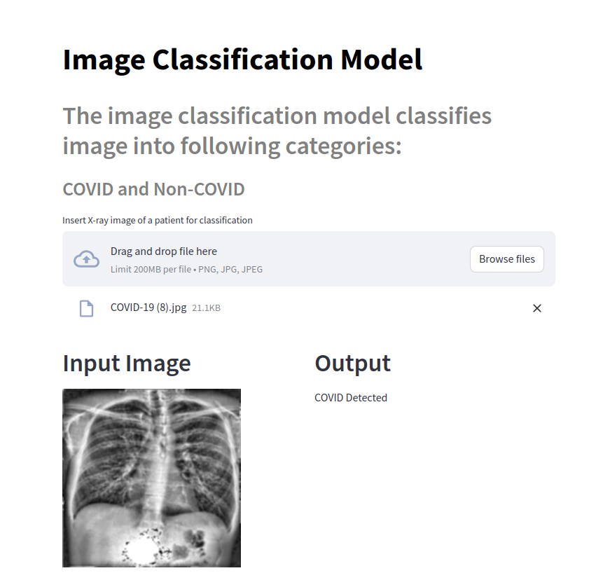
IMPACT HUB CHALLENGE

Slide 11

Min Htet Myet Steven Yan Asha Maheshwari Prabhat Upadhyay Pravesh Pradheep Luke Gomm Utkarsha Khanal Vinayaga Moorthy Daniel Adediran Akash Rajput José Zerna Claren Ogira Shahab Syed Lemi Debela Walid Hossain Reza Mahmoudi Isidre Munné Insaf Hamdi Mohamed Chahed Garima Kapoor Mohamed Mahmoud Rohit Singh Amol Shivle JC Mae Peroz Marwan Ashraf Yinka Okunola Ardis Hakim Dhekra Hajji Nitha Kumar Thenu Seelan Walid Hossain Yash Sethi
List of Collaborators:
Looking forward to collaborating
In next projects
-Min Htet Myet
Thank you!

